Slide 1
Customer Retention Project
Submitted by-
Kritanjay Singh

Slide 2
Customer Retention Project Problem Statement
Customer satisfaction has emerged as one of the most important factors that guarantee the success of online store; it has been posited as a key stimulant of purchase, repurchase intentions and customer loyalty. A comprehensive review of the literature, theories and models have been carried out to propose the models for customer activation and customer retention. Five major factors that contributed to the success of an e-commerce store have been identified as: service quality, system quality, information quality, trust and net benefit.
The research furthermore investigated the factors that influence the online customers repeat purchase intention. The combination of both utilitarian value and hedonistic values are needed to affect the repeat purchase intention (loyalty) positively. The data is collected from the Indian online shoppers. Results indicate the e-retail success factors, which are very much critical for customer satisfaction.

Slide 3
Solution
Analysis the given dataset and find the factors which are very useful for the growth of online business and also show the data visualization of the dataset. Here we need to do only data analysis of the dataset. And show the outcome of the process and the observations we find through the process.
Online business or e-commerce is very useful and come in a very large scale and for the satisfaction of the customers find the factors which help to understand that what customer really wants and what they expect from the online shopping , so that they can again buy from the online e-tailer more and recommend to their friends.

Slide 4
EXPLORATORY DATA ANALYSIS
Exploratory Data Analysis(EDA) is an approach of analyzing data sets to summarize their main characteristics, often using statistical graphics and other data visualization methods.
Here we check our data and understand what kind of data is present to us and then explore the data more.
Then visualize our data with the help of different plots with the help of python libraries such as Matplotlib as Seaborn.

Slide 5
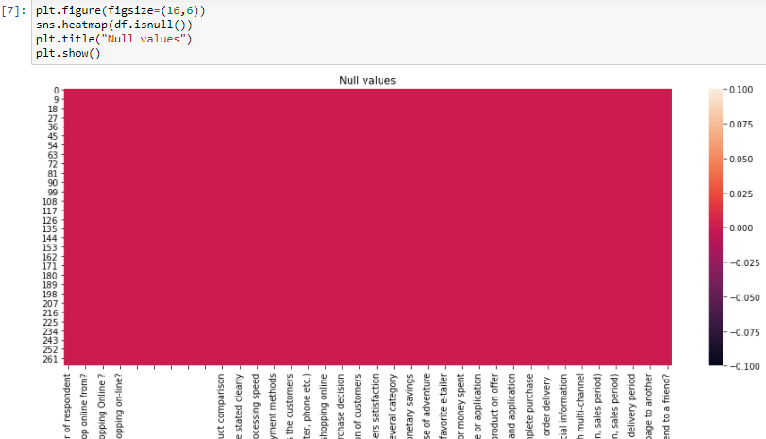
EDA contd.
The plot we used are :
Heatmap : A Heatmap is used to check the correlation among the features and also with target column. Here we used Heatmap to check the null values.

Slide 6
Contd.
Bar graph –
A bar chart or bar graph is a chart or graph that presents categorical data with rectangular bars with heights or lengths proportional to the values that they represent.
Here we have all the categorical data that’s why we use bar graph to represent them.

Slide 7
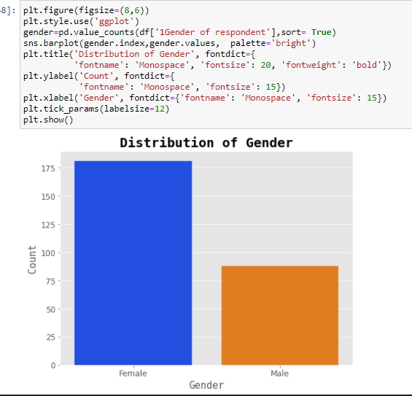
Contd..
Here we can see that the females are very high in number when it comes to online shopping.

Slide 8
Contd.
First we find the shape of the data . In the dataset we have 269 rows and 71 columns
The datatypes of the columns were 70 object datatype and 1 integer type datatype.
After that we check the null values and hence there was no null values present in the dataset.
As we have all object datatype we find value counts of the categorical data and then plot the different categorical Data with the help of matplotlib and seaborn libraries.

Slide 9
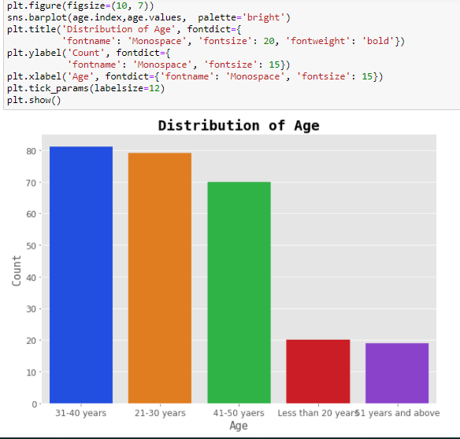
Contd..
Here we find the distribution of age and hence we find that the most of the people who are using online shopping are from 21 to 40 years of age.

Slide 10
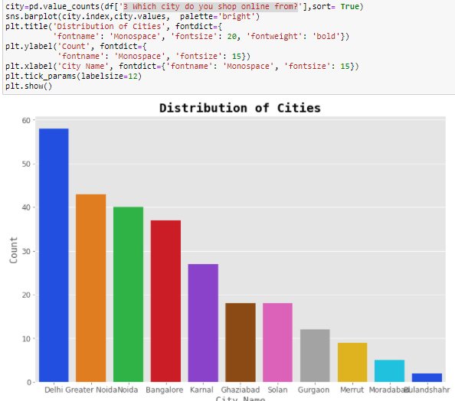
Contd..
Then we check the cities where online shopping is done more and we find that most of the people are from the Delhi ,Greater Noida , Noida and Bangalore.

Slide 11
Conclusion
The most of the Online customers are females while males are very less in comparison to them.
The Age group of Online customers are maximum in between 21-40 years i.e. the college and job person are very fond of online shopping.
The Maximum Online customers are from the Delhi , Noida , Greater Noida and Bangalore.
Most of the people have the 4+ years of experience in online shopping.
Most people use the Mobile Internet while doing the online shopping.
Most of the people use the Mobile and the laptop for the online shopping.

Slide 12
Contd..
Credit/Debit cards are mostly preferred by the people for the payments.
Most of the people read and understand the information which is present on the website and agree with all the data given in the website.
Most of the people preferred Amazon.in and flipkart.com for the online shopping.
Paytm and Snapdeal are very least used website for the online shopping , while amazona and flipkart are very highly using websites.
Paytm and Snapdeal have very slow delivery time.
While Amazon.in is the fastest delivery online store.

Slide 13
Contd.
Among flipkart and Amazon.in, Amazon is more used by the people.
Amazon provides security, quick purchasing, many payements options, fastest delivery, trustworthy and easy to use and understand interface.
Amazon provides the data security andof also the privacy person information is safe.
Hence most of the people use Amazon maximum time and after that they use the flipkart for the Online shopping.

Slide 14
THANKYOU.

